Slide 1
Outline
Course: MISS 1102: Secure Software Design
Course objectives
Course outcome
Course content, Laboratory and case studies
Reference books
Why do we need to study secure software design?
What is security and cybersecuty?
CIA triad
Three pillars of cybersecurity
Some ICT indices and Bangladesh Position in the world
Dimensions of cybersecurity : for assessing the cybersecurity preparedness of a country

Slide 2
MISS-1102: Secure Software Design, Credit Hour: 3.0
Course Objectives
To understand the role of security in the Software Development Life Cycle (SDLC) process and explain it clearly
To understand the impact of security principles and practices on a software product, which is essential to consider in SDLC
To master comprehensive development considerations for ensuring a secure software system
To get oriented with the best cyber-attacks the best coding practices for ensuring system security against the most common and impactful cyber-attacks
To get acquainted with software UI design considerations and practices for designing more secure websites and applications

Slide 3
Course Outcomes
Upon completing the course, the students will be able to:
Understand the principles of designing secure software architecture, including the use of security patterns and best practices.
Identify, define, and integrate security requirements into the software development process.
Conduct threat modeling to identify, assess, and prioritize potential security risks.
Write secure code, identify common programming vulnerabilities, and conduct code reviews and static code analysis.
Design secure authentication mechanisms and implement proper authorization controls.
Handle sensitive data securely, including the use of encryption and hashing techniques and database security considerations.
Identify common web and mobile application vulnerabilities, write secure code for these applications, and implement security measures like web application firewalls.
Integrate security into the DevOps pipeline and implement continuous integration and continuous deployment (CI/CD) security practices.
Understand how to prepare for and respond to security incidents during development, maintain security during software updates, and implement patch and vulnerability management practices.
Analyze security risks and make informed decisions about security measures and effectively communicate security concepts and recommendations to stakeholders.

Slide 4
Course Content
Introduction to Secure Software Development: Overview of secure software development principles, Importance of integrating security into the software development life cycle (SDLC).
Security Requirements Engineering: Identifying and defining security requirements, integrating security requirements with functional requirements.
Threat Modelling: Techniques for identifying and assessing potential security threats, creating threat models to analyze and prioritize risks.
Secure Architecture Design: Principles of designing secure software architecture, Security patterns and best practices for system design,
Secure Coding Practices: Writing secure code and common programming vulnerabilities, Code reviews and static code analysis for security.
Authentication and Authorization: Designing secure authentication mechanisms, Implementing proper authorization controls.
Data Security: Secure handling of sensitive data, Encryption and hashing techniques, Database security considerations.
Web Application Security: Common web application vulnerabilities, Secure coding for web applications, Web application firewalls.
Mobile Application Security: Security considerations for mobile app development, Securing data storage and transmission in mobile apps.
Secure DevOps and CI/CD: Integrating security into the DevOps pipeline, Continuous integration and continuous deployment (CI/CD) security.
Security Testing: Types of security testing (e.g., penetration testing, code review), Automated and manual security testing approaches.
Secure Software Development Tools: Introduction to security tools for developers, Code scanning tools, static analyzers, and other security-related tools.
Secure Software Development Frameworks: Overview of secure development frameworks, Integrating security features from established frameworks.
Secure Software Development Standards and Compliance: Overview of security standards (e.g., CMM, OWASP, NIST, PCI SLC, PCI S3), Ensuring compliance with industry-specific security requirements.
Incident Response in Software Development: Preparing for and responding to security incidents during development, Secure rollback and recovery processes.
Secure Software Maintenance: Best practices for maintaining security during software updates, Patch management and vulnerability management.
Legal and Ethical Considerations: Understanding legal and ethical responsibilities in secure software development, Privacy considerations and compliance.

Slide 5
Laboratory and Case Study
Case Study Secure Software Business Requirement Analysis
Case Study Secure Software Systems Architecture
Lab on Secure Coding using a software development framework
Lab on Static Code Analysis using different static software testing tools
Lab on Dynamic Code Analysis using different Dynamic software testing tools
Lab on Application VAPT considering OWASP to 10 and SANS 25 Dangerous software error, i.e. SQL Injection, Broken Authentication, CSS, CSRF, etc.
Course Final Project Assignment on Software VAPT

Slide 6
Reference Books
Theodor Richardson, Charles N Thies, Secure Software Design.
Loren Kohnfelder, Designing Secure Software: A Guide for Developers.

Slide 7
Why do we need secure software design/development ?

Slide 8
Why do we need secure software design/development ?
Secure software development is crucial because it ensures that software is built with security as a core consideration from the very beginning, rather than being treated as an afterthought. Here are the key reasons why secure software development is essential:
1. Prevents Vulnerabilities and Exploits
Software vulnerabilities (e.g., SQL injection, buffer overflows, cross-site scripting) are common targets for attackers.
Secure development practices, such as code reviews, static analysis, and secure coding standards, help identify and eliminate vulnerabilities early in the development lifecycle.

Slide 9
Continue..
2. Reduces Risk of Data Breaches
Data breaches can result in the loss of sensitive information (e.g., personal, financial, or health data).
Secure development ensures that data is handled, stored, and transmitted securely, minimizing the risk of unauthorized access or leaks.
3. Protects User Trust
Users expect their data and systems to be secure.
A single security incident can erode trust, damage an organization's reputation, and lead to loss of customers or revenue

Slide 10
Continue..
4. Compliance with Regulations
Many industries are subject to strict security and privacy regulations (e.g., GDPR, HIPAA, PCI-DSS).
Secure development ensures compliance with these regulations, avoiding legal penalties, fines, and reputational damage.
5. Cost-Effective in the Long Run
Fixing security issues after deployment is significantly more expensive than addressing them during development.
Secure development reduces the likelihood of costly breaches, downtime, and emergency patches.

Slide 11
Continue..
6. Mitigates Risks in a Connected World
Modern software is often interconnected with other systems, devices, and services (e.g., cloud, IoT).
Vulnerabilities in one component can compromise an entire ecosystem, making secure development critical for overall system resilience.
7. Ensures Business Continuity
Security incidents can disrupt operations, leading to downtime, lost productivity, and revenue loss.
Secure development helps build resilient systems that can withstand attacks and maintain availability.

Slide 12
Continue..
8. Defends Against Evolving Threats
Cyber threats are constantly evolving, with attackers using advanced techniques to exploit weaknesses.
Secure development practices, such as threat modeling and penetration testing, help anticipate and mitigate these threats.
9. Supports Secure Software Lifecycle
Security is not a one-time task but an ongoing process.
Secure development integrates security into every phase of the software development lifecycle (SDLC), from design to deployment and maintenance.

Slide 13
Continue..
10. Ethical Responsibility
Developers and organizations have a moral obligation to protect users and their data from harm.
Secure development ensures that software does not inadvertently enable malicious activities or cause harm.
Key Practices in Secure Software Development:
Threat Modelling: Identify potential threats and vulnerabilities early in the design phase.
Secure Coding Standards: Follow best practices to avoid common vulnerabilities.
Code Reviews and Static Analysis: Detect and fix security issues in the code.
Penetration Testing: Simulate attacks to identify weaknesses.
Input Validation and Sanitization: Prevent injection attacks and other exploits.
Encryption: Protect sensitive data in transit and at rest.
Regular Updates and Patching: Address vulnerabilities promptly.

Slide 14

Security
Security can be defined as -
“The state of being free from danger or threat”
“Security is the right not to have one’s activities adversely affected via tampering with one’s objects.”
Security is all about knowing who and what to trust.
It is important to know when and when not to take a person at their word and when the person you are communicating with & what they say who they are.

Slide 15
What is cybersecurity?
Cyber security is the practice of defending computers, servers, mobile devices, electronic systems, networks, and data from malicious attacks.
Or
Cyber security is the application of technologies, processes, and controls to protect systems, networks, programs, devices and data from cyber attacks.
Or
Cyber security refers to every aspect of protecting an organization and its employees and assets against cyber threats.

Slide 16
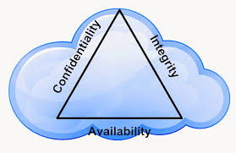
CIA Triad
Confidentiality
Integrity
Availability

Slide 17
Confidentiality
Confidentiality is the concealment of information or resources.
The need for keeping information secret arises from the use of computers in sensitive fields such as government and industry. For example, military and civilian institutions in the government often restrict access to information to those who need that information.
Access control mechanisms support confidentiality. One access control mechanism for preserving confidentiality is cryptography, which scrambles data to make it incomprehensible.
Standard measures to establish confidentiality include: Data Encryption, Two-factor authentication, Biometric Verification, Security Tokens etc.

Slide 18
Integrity
Integrity refers to the trustworthiness of data or resources, and it is usually phrased in terms of preventing improper or unauthorized change. Integrity includes data integrity (the content of the information) and origin integrity (the source of the data, often called authentication).
Integrity mechanisms fall into two classes: prevention mechanisms and detection mechanisms.
Prevention mechanisms seek to maintain the integrity of the data by blocking any unauthorized attempts to change the data or any attempts to change the data in unauthorized ways.
Detection mechanisms do not try to prevent violations of integrity; they simply report that the data’s integrity is no longer trustworthy.
Standard measures to guarantee Integrity include: Cryptography checksums Using file permissions, Uninterrupted power supplies, Data backups etc.

Slide 19
Difference between confidentiality and integrity
Working with integrity is very different from working with confidentiality. With confidentiality, the data is either compromised or it is not, but integrity includes both the correctness and the trustworthiness of the data.
The origin of the data (how and from whom it was obtained), how well the data was protected before it arrived at the current machine, and how well the data is protected on the current machine all affect the integrity of the data.
Thus, evaluating integrity is often very difficult, because it relies on assumptions about the source of the data and about trust in that source—two underpinnings of security that are often overlooked.

Slide 20

Availability
Its ensure that required data is always accessible when and where needed within an organization's IT infrastructure, even when disruptions occur. The concerns are:
Will critical systems go down at the client, if the provider is attacked in a Denial of Service attack?
What happens if cloud provider goes out of business?
Would cloud scale well-enough?
Often-voiced concern-
Although cloud providers argue their downtime compares well with cloud user’s own data centers

Slide 21
Availability
Availability is an important aspect of reliability as well as of system design because an unavailable system is at least as bad as no system at all. The aspect of availability that is relevant to security is that someone may deliberately arrange to deny access to data or to a service by making it unavailable.
Attempts to block availability, called denial of service attacks, can be the most difficult to detect, because the analyst must determine if the unusual access patterns are attributable to deliberate manipulation of resources or of environment.
Standard measures to guarantee Availability include: Backing up data to external drives, Implementing firewalls, having backup, power supplies data redundancy etc.

Slide 22
Cybersecurity Problems/Needs
OR
Three Pillars of Cybersecurity
(People Process and Technology)

Slide 23
Cybersecurity: People Problems (Pillar 1)
A company may have purchased the best security technologies that money can buy, trained their people so well that they lock up all their secrets before going home at night, and hired building guards from the best security firm in the business. - That company is still totally vulnerable.
Individuals may follow every best-security practice recommended by the experts, slavishly install every recommended security product, and be thoroughly vigilant about proper system configuration and applying security patches. - Those individuals are still completely vulnerable

Slide 24
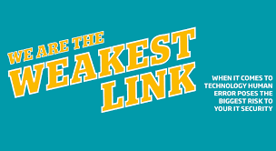
Human Factor: Security’s weakest link
Anyone who thinks that security products alone offer true security is settling for the illusion of security.
It is a case of living in a world of fantasy: they will inevitably, later if not sooner, suffer a security incident.
Why?
Because the human factor is truly security’s weakest link.
Notes:
As technological defences become more robust, cyber criminals are increasingly using social engineering techniques to exploit the weakest link in the security chain: people.

Slide 25
Other Pillars of Cybersecurity
It’s a common misconception that cyber security is all about technology (hardware and software). Technology is obviously a massive part of cyber security, but alone it is not enough to protect you from modern cyber threats.
Cyber security consists of technologies, processes and measures that are designed to protect individuals and organizations from cyber crimes. Effective cyber security reduces the risk of a cyber attack through the deliberate exploitation of systems, networks and technologies.
Effective and robust cyber security requires an information security management system (ISMS) built on three pillars: people, processes and technology.

Slide 26
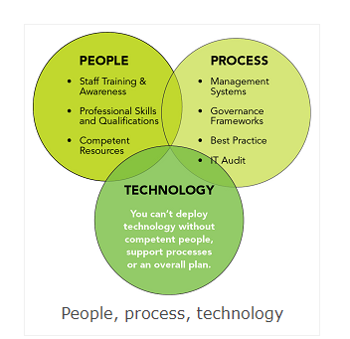
Three Pillars of Cybersecurity

Slide 27
Some Global ICT indices

Slide 28
Some important indexes of ICT
To measure the strength of ICT development, deployment, usages- there are various standard indexes are used using various relevant parameters. 5 such indexes for your information. This indexes will help you to understand the current level of ICT development and deployment in Bangladesh.
Networked Readiness Index (NRI)
ICT Development Index (IDI)
E-Government Development Index (EGDI)
Global Cybersecurity Index (GCI)
National Cyber Security Index (NCSI)

Slide 29
Networked Readiness Index (NRI)
It is introduced by World Economic Forum (WEF).
The WEF assesses the impact of ICT on the competitiveness of the nations of the world. The 3 components of NRI are :
i) Environment for ICT (market, political and regulatory, infrastructural environment),
ii) The Stakeholders (individuals, businesses and government) to use ICT, and
iii) The usage of ICT.
In 2024, Bangladesh is in 91th position.

Slide 30
ICT Development Index (IDI)
It is introduced by International Telecommunication Union (ITU). The IDI is a valuable tool for benchmarking the most important indicators for measuring information society or impact of ICT in the society.
This index is dependent on eleven indicators, is grouped into 3-major categories:
ICT readiness (Infrastructure, access) - reflecting the level of networked infrastructure and access to ICTs,
ICT Use (Intensity) - reflecting the level of use of ICTs in the society and
iii) ICT capability (Skills) - reflecting the results/outcomes of more efficient and effective ICT use.
In 2023, Bangladesh score is 61.1 whereas Sri Lanka registering a score of 69.9, Bhutan 76.5, Vietnam 80.6, Maldives 79 and Cambodia 68.5.

Slide 31
E-Government Development Index (EGDI)
It is introduced by United Nations. The EGDI evaluates the impact of ICT on the political economy of a country.
This index focuses on how the governments use ICT to deliver services to the people and opportunities for citizens to participate in decision making process.
The EGDI consists of 3-components:
i) Online service,
ii)Technological infrastructure and
iii) Human capital.
In 2024, Bangladesh is 111th position).

Slide 32
Global Cybersecurity Index (GCI)
It is introduced by ITU. The GCI results show overall improvement and strengthening of all 5 pillars of the cybersecurity agenda:
i) Legal measures,
ii) Technical measures,
iii) Organizational measures,
iv) Capacity development measures, and
v) Cooperation measures.
In 2024, Bangladesh is 53th position).

Slide 33
National Cyber Security Index (NCSI)
It is introduced by NCSI Project Team (e-Governance Academy Foundation), Estonia. The NCSI measures the preparedness of countries to prevent cyber threats and manage cyber incidents.
The NCSI is also a database with publicly available evidence materials and a tool for national cyber security capacity building.
The NCSI focuses on 4-measurable aspects of cyber security :
i) Legislation in force – Legal acts, regulations, orders, etc.,
ii) Established units – Existing organizations, departments, etc.,
iii) Cooperation formats – Committees, working groups, etc. and,
iv) Outcomes – Policies, exercises, technologies, websites, programs, etc.
In 2024, Bangladesh s is 36th position.

Slide 34
Various Dimensions of Cybersecurity

Slide 35
Assessing National Cybersecurity Capacity
The Capacity Maturity Model (CMM) considers cybersecurity to comprise five Dimensions which, together, constitute the breadth of national capacity that a country requires to be effective in delivering cybersecurity:
Developing cybersecurity policy and strategy,
Encouraging responsible cybersecurity culture within society;
Building cybersecurity knowledge and capabilities;
Creating effective legal and regulatory frameworks; and
Controlling risks through standards and technologies.

Slide 36
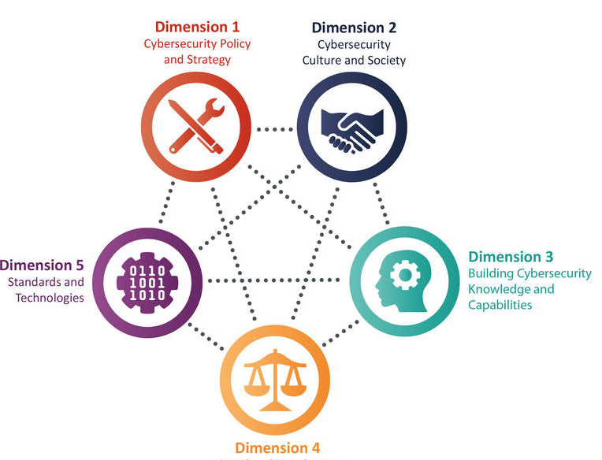
Dimensions of cybersecurity: Capcity maturity Model (CMM)

Slide 37
Dimensions
Dimension 1 : Cybersecurity Policy and Strategy
Cybersecurity Policy and Strategy explores the country’s capacity to develop and deliver cybersecurity strategy, and to enhance its cybersecurity resilience by improving its incident response, cyber defence and critical infrastructure (CI) protection capacities.
This Dimension considers effective strategy and policy in delivering national cybersecurity capability, while maintaining the benefits of a cyberspace vital for government, international business and society in general.
Dimension 2 : Cybersecurity Culture and Society
Cybersecurity Culture and Society reviews important elements of a responsible cybersecurity culture such as the understanding of cyber-related risks in society, the level of trust in Internet services, e-government and e-commerce services, and users’ understanding of personal information protection online.
Moreover, this Dimension explores the existence of reporting mechanisms functioning as channels for users to report cybercrime. In addition, this Dimension reviews the role of media and social media in shaping cybersecurity values, attitudes and behaviour.

Slide 38
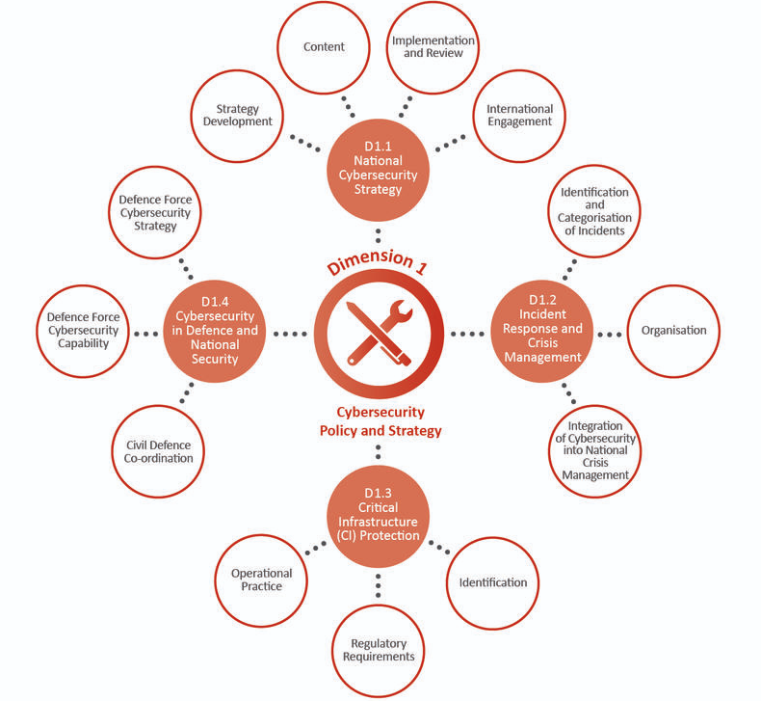
Dimension 1: Cybersecurity Policy and Strategy

Slide 39
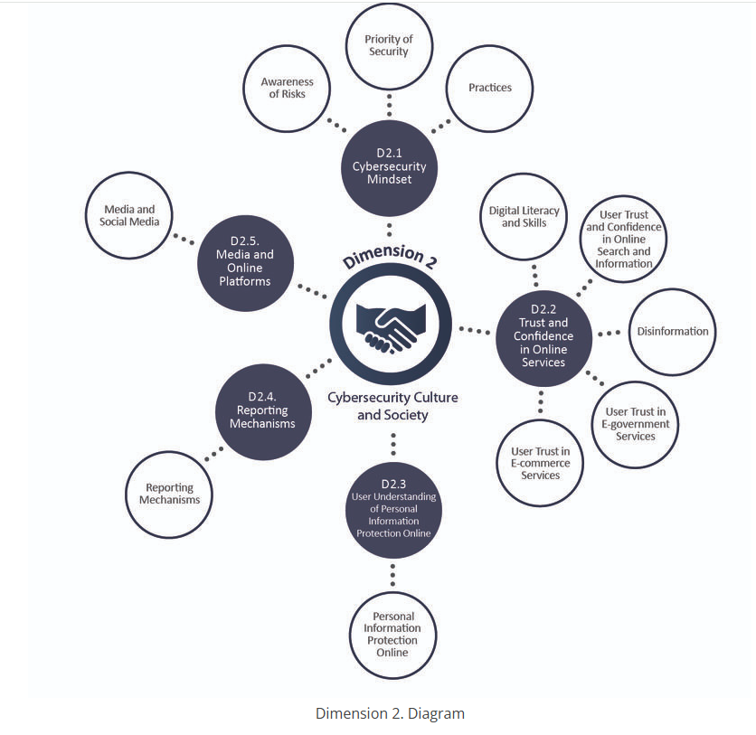
Dimension 2: Cybersecurity Culture and Society

Slide 40
Dimensions
Dimension 3: Cybersecurity Knowledge and Capabilities
Building Cybersecurity Knowledge and Capabilities reviews the availability, quality and uptake of programmers for various groups of stakeholders, including the government, private sector and the population as a whole, and relate to cybersecurity awareness-raising programmers, formal cybersecurity educational programmes, and professional training programmers.
Dimension 4: Legal and Regulatory Frameworks
Legal and Regulatory Frameworks examines the government’s capacity to design and enact national legislation that directly and indirectly relates to cybersecurity, with a particular emphasis placed on the topics of regulatory requirements for cybersecurity, cybercrime-related legislation and related legislation.
The capacity to enforce such laws is examined through law enforcement, prosecution, regulatory bodies and court capacities. Moreover, this Dimension observes issues such as formal and informal co-operation frameworks to combat cybercrime.
Dimension 5 : Standards and Technologies
Standards and Technologies addresses effective and widespread use of cybersecurity technology to protect individuals, organisations and national infrastructure.
This Dimension specifically examines the implementation of cybersecurity standards and good practices, the deployment of processes and controls, and the development of technologies and products in order to reduce cybersecurity risks.

Slide 41
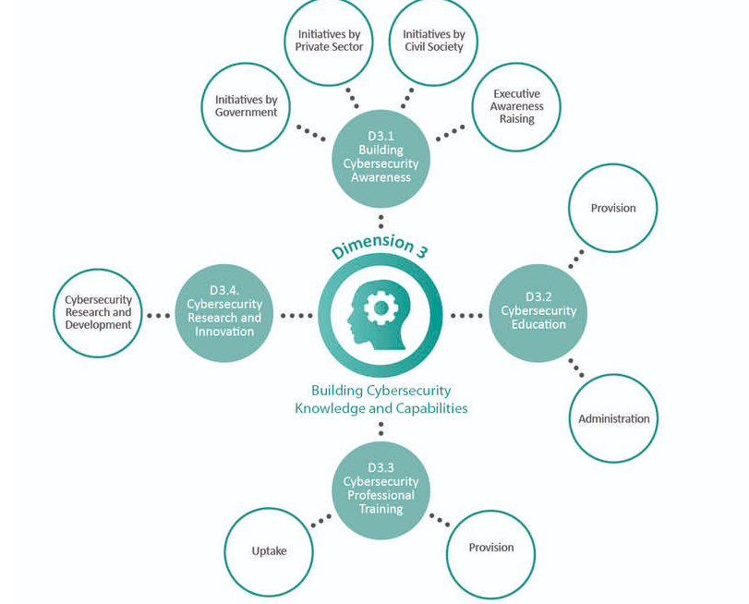
Dimension 3: Cybersecurity Knowledge and Capabilities

Slide 42
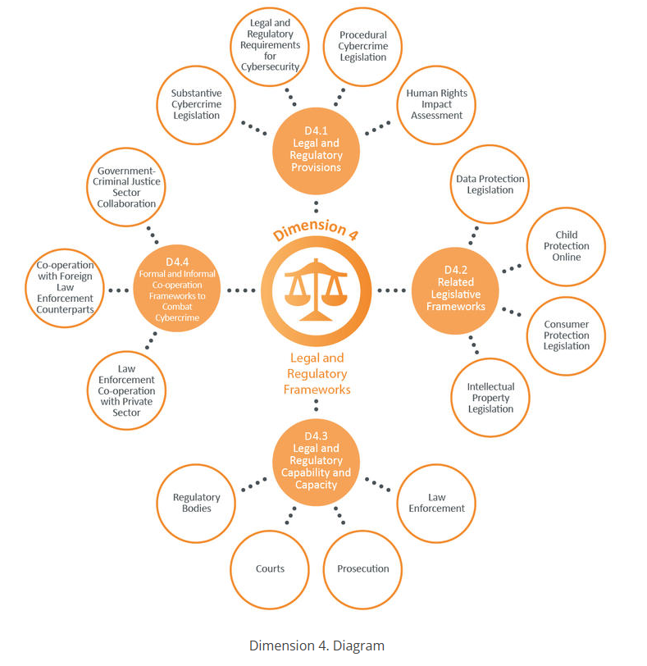
Dimension 4: Legal and Regulatory Frameworks

Slide 43
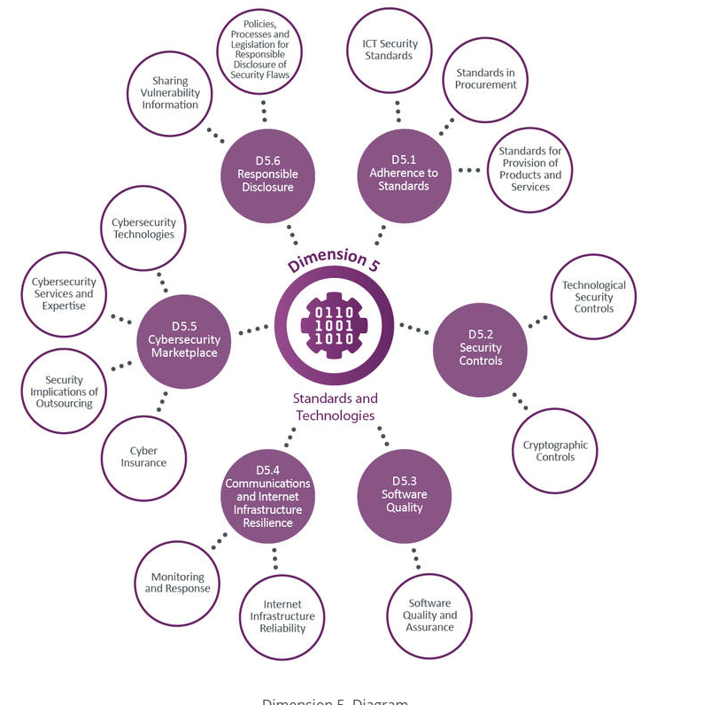
Dimension 5: Standards and Technologies

Slide 44
Final Comments on Capacity Maturity Model (CMM)
The CMM defines five Stages of maturity for all Dimensions being: start-up, formative, established, strategic, and dynamic. These correspond to the following: initial development of capacity, being established, being world-leading, and able to anticipate and prepare for future cybersecurity needs.
It should be noted that there are relationships between the Dimensions; for example, to be effective in one area of capacity often places requirements on other areas. It is also the case that resources are limited and priorities for capacity enhancements are likely to require a response which could span multiple Dimensions. Therefore, a benchmarking activity reviews a country against the entire CMM and across all Dimensions, enabling an holistic consideration of national capacity.

